Slide 1
Iteration Two
Matt Giles
Hunter Michalk
Jameson Axton
Caleb DeHaan

Slide 2
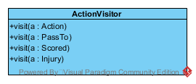
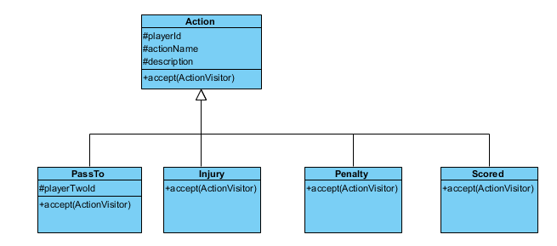
Visitor

Slide 3
Purpose
Visitor separates code that changes frequently from code that never changes
Frequent change: What do we do with each action? (Record stats, turnover, etc.)
Infrequent change: A pass is a pass. The implementation of what a pass does to the stats might need to be changed in the future, but the class is just a label (doesn’t change).

Slide 4
Good coding practices: GRASP
Low Coupling: Team does not know what a Game is
High Cohesion: Action is extended, each subclass has a new responsibility
Controller: GUI sends information via Actions and GameHandler

Slide 5
Things to come
Database
Log in system
Upgraded UI

Slide 6
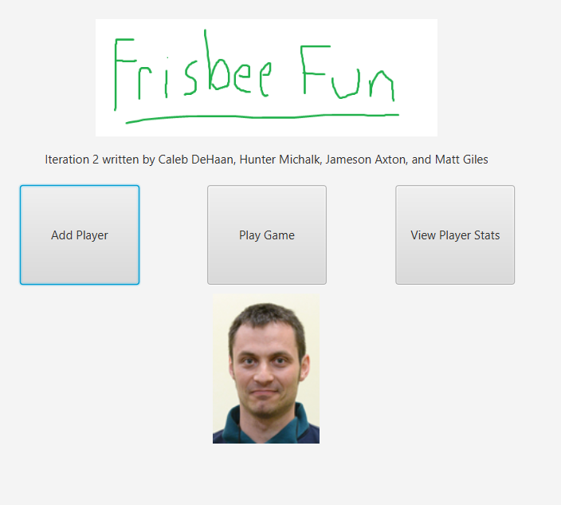
Backup: Pictures of GUI

Slide 7
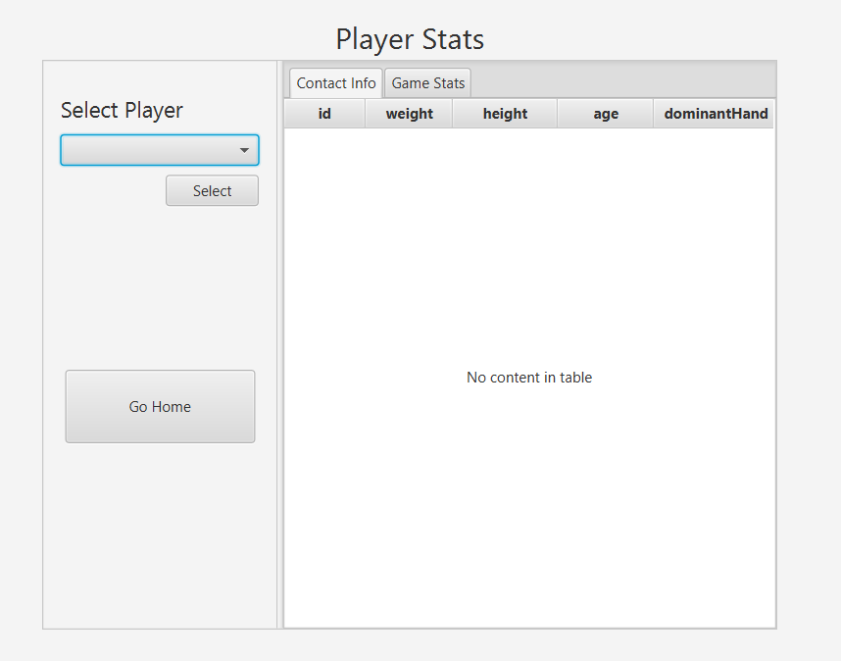
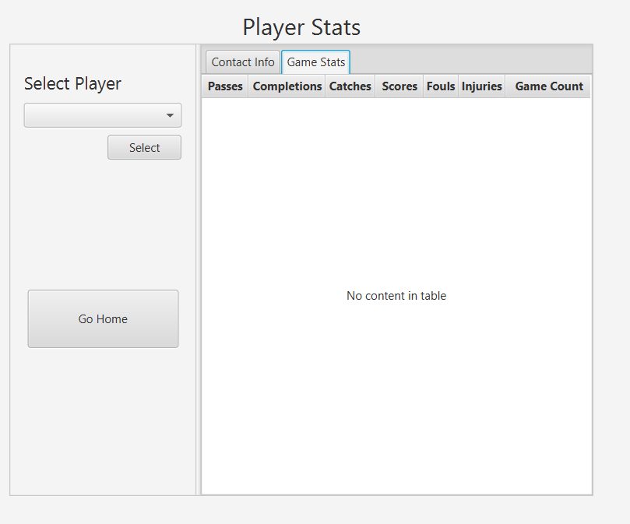

Slide 8
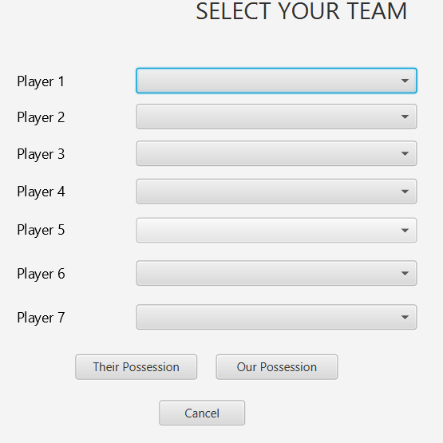
Team Select

Slide 9
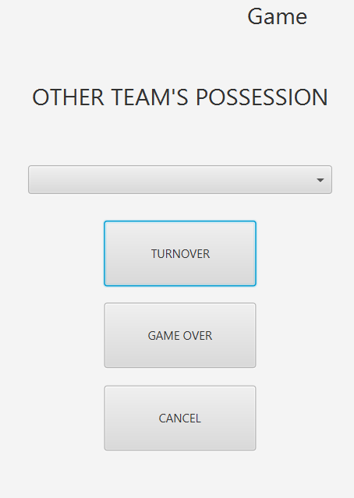
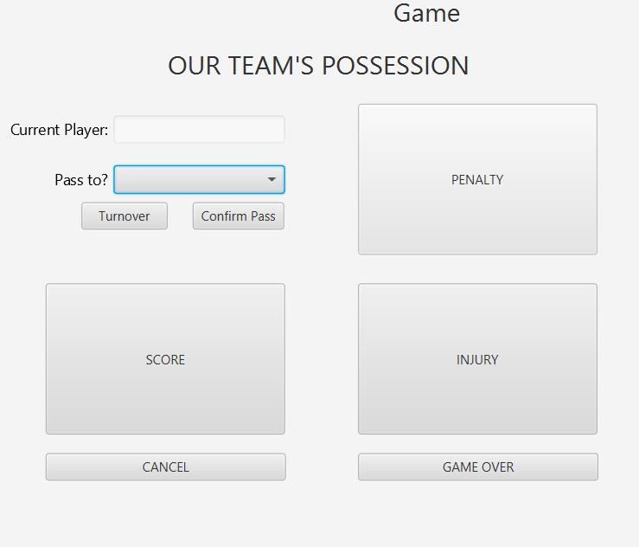
Posession

Slide 10
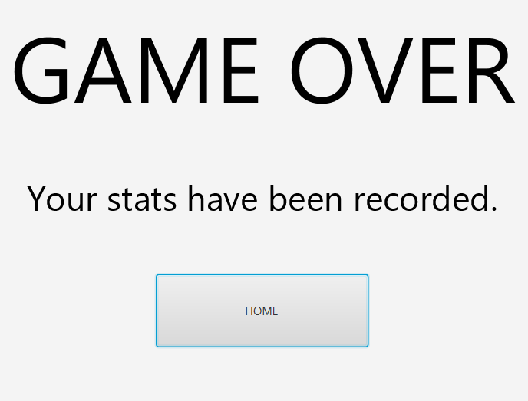
Game finish

Slide 11
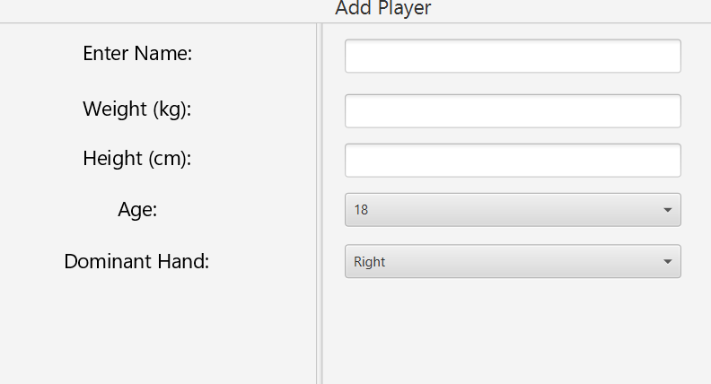
Add Player

